Slide 1



Slide 2
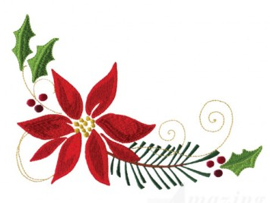
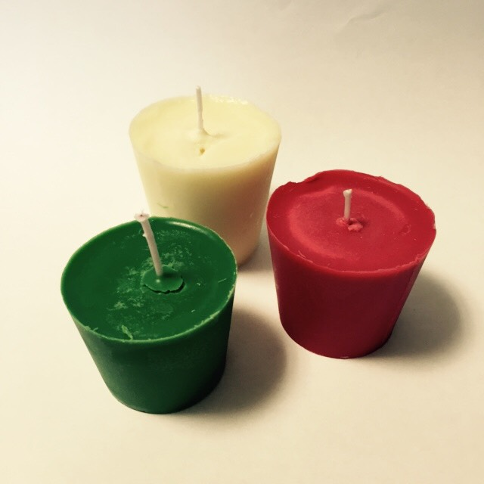

Slide 3



Slide 4


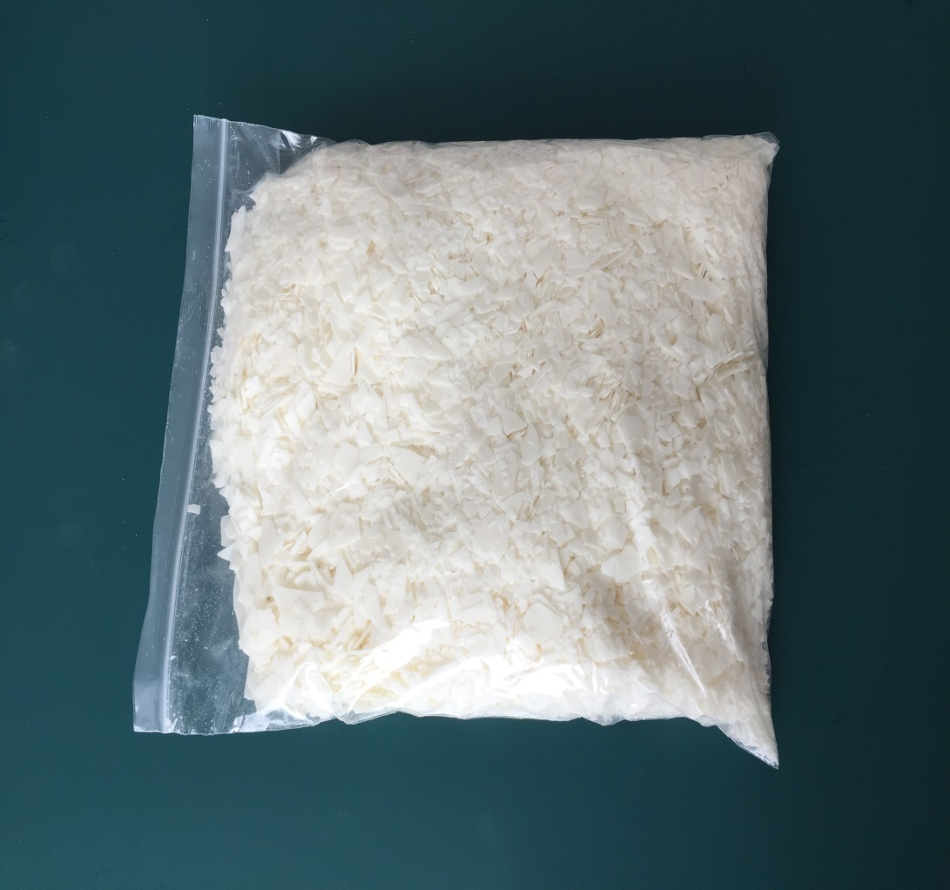
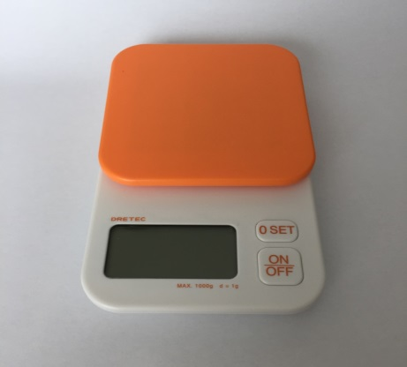
    1KG/25 mini cups
    soy wax
    Option:
    scale

Slide 5
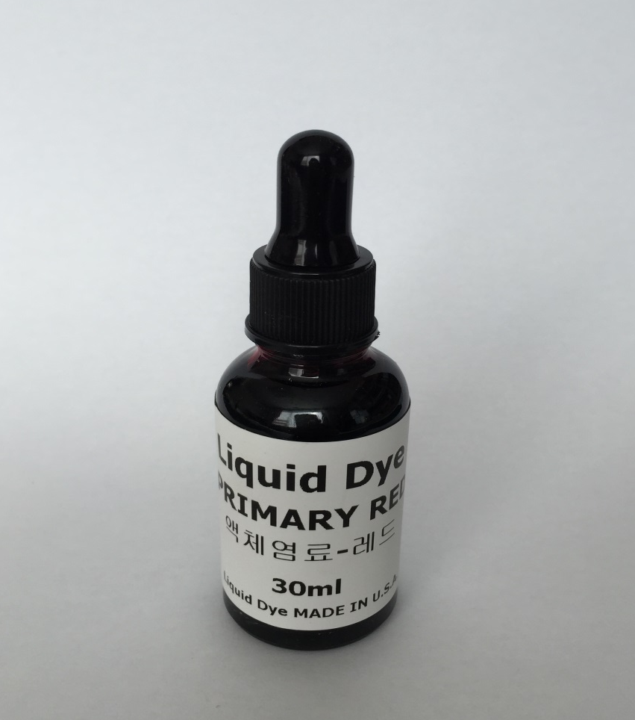
    5 drops
    coloring

Slide 6
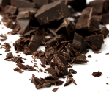
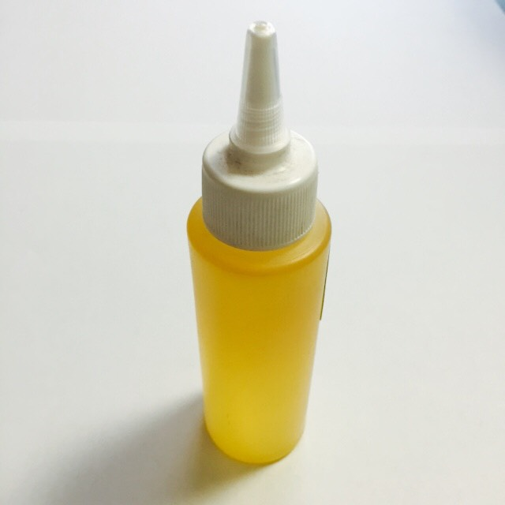

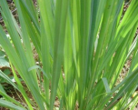
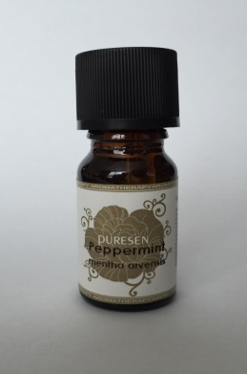
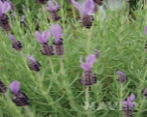
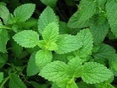
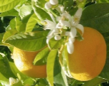
    Today’s Fragrance
    초콜릿
    잉글리쉬페어 & 프리지아
    그 외 Fragrance
    시트로넬라: 모기퇴치용
    라벤다: 숙면
    페퍼민트: 두통
    버가못: 스트레스 해소
    10ml
    100ml
    candle fragrance

Slide 7
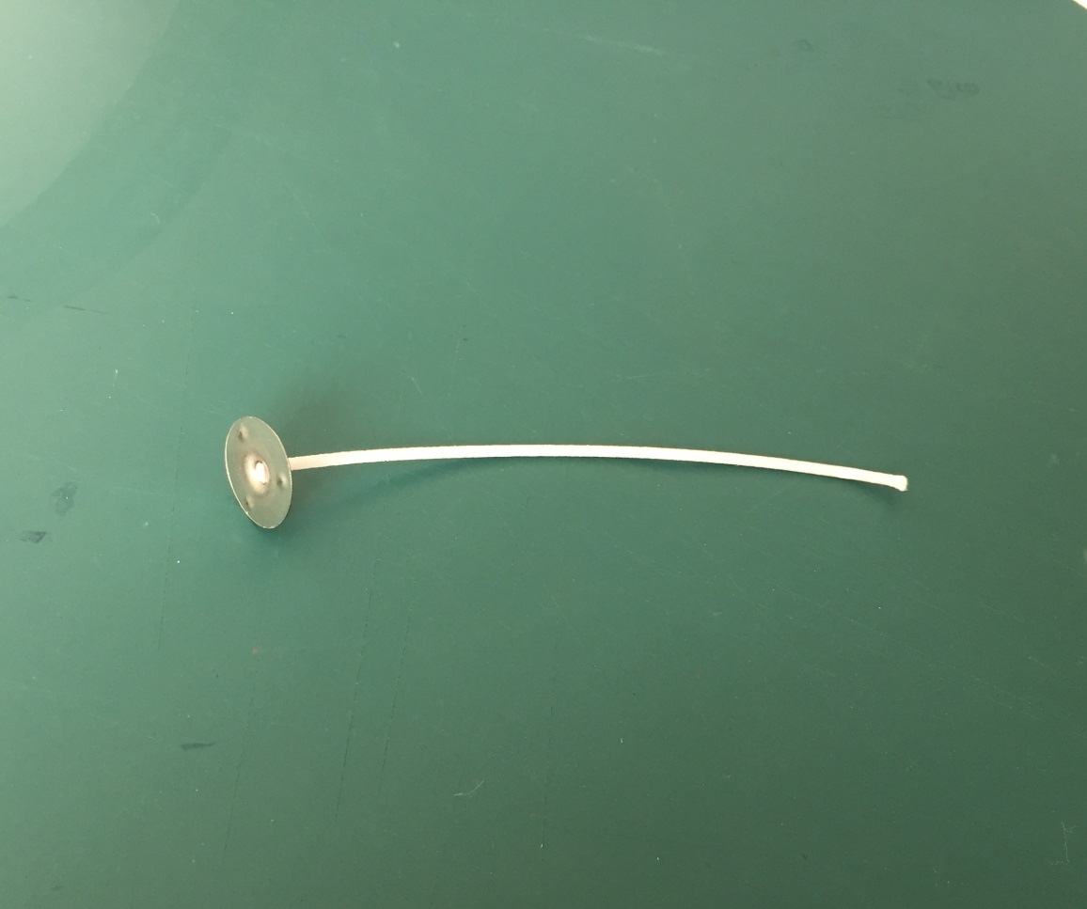
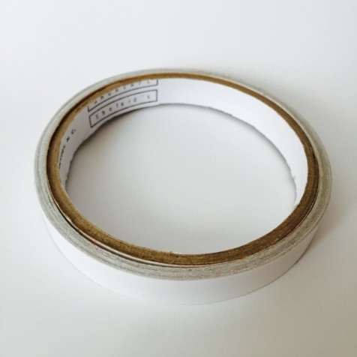
    wicks
    Option:
    sticky tape

Slide 8
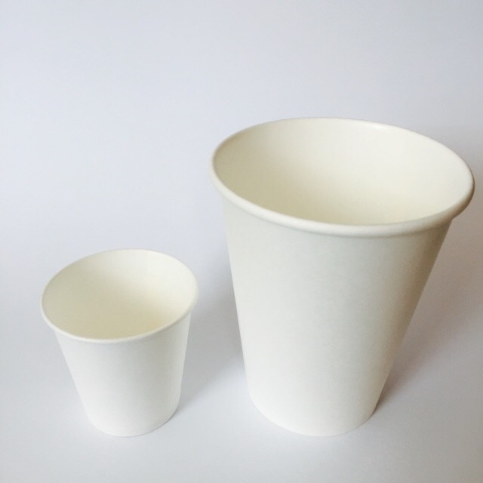
    paper cups

Slide 9
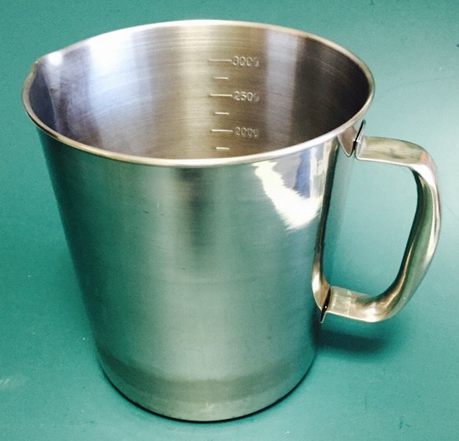
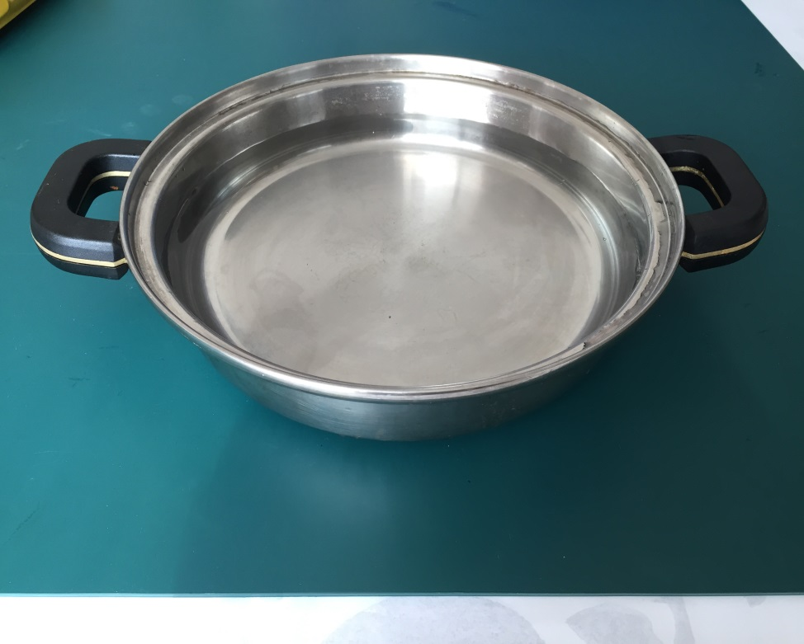
    heat safe containers

Slide 10
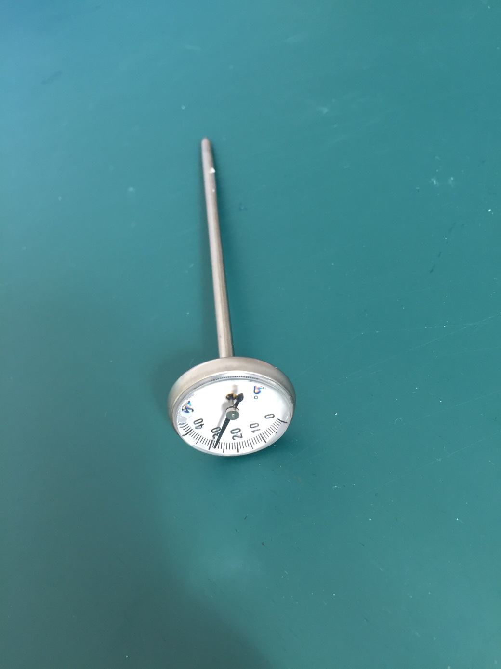
    thermometer

Slide 11
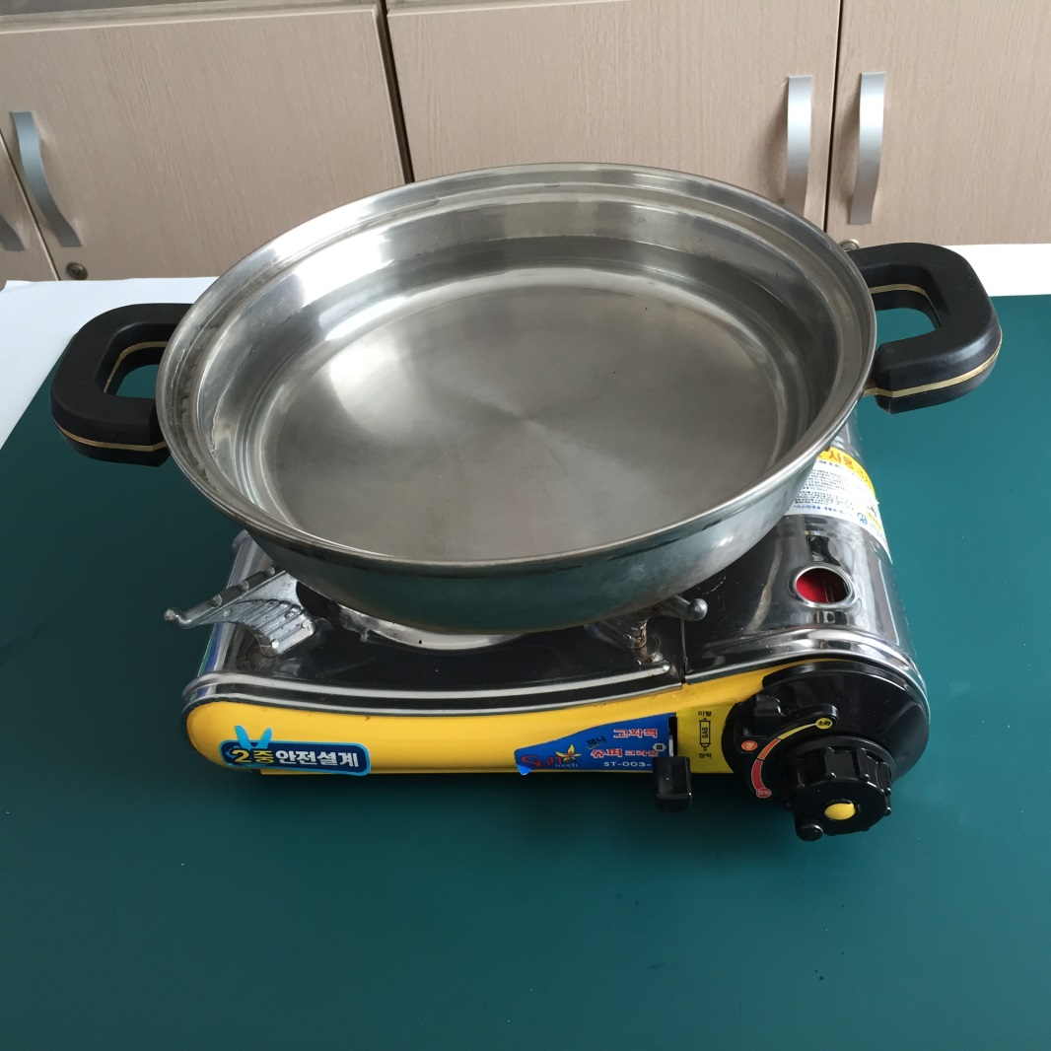
    boiling water

Slide 12
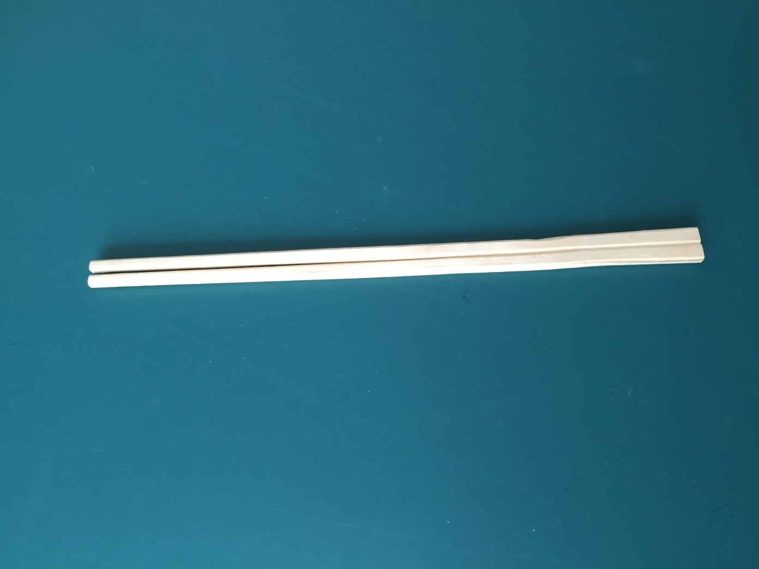
    wooden sticks

Slide 13


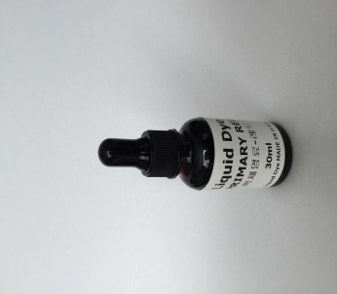

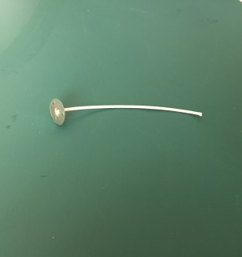

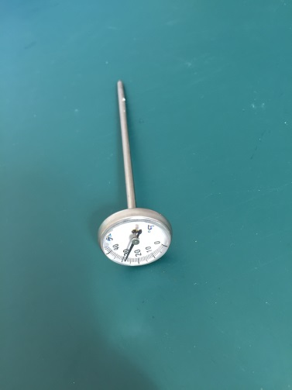

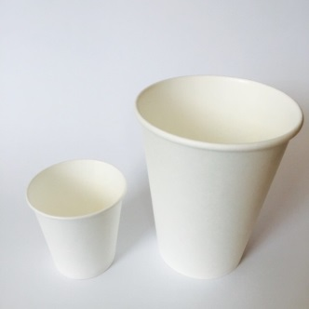

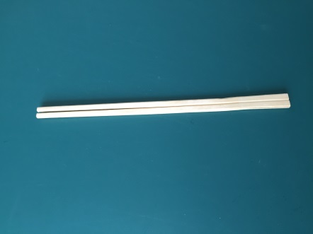
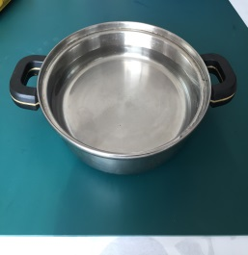
    soy wax
    scale
    candle
    fragrance
    wicks
    sticky tape
    coloring
    heat safe
    containers
    boiling
    water
    paper cups
    thermometer
    wooden sticks

Slide 14
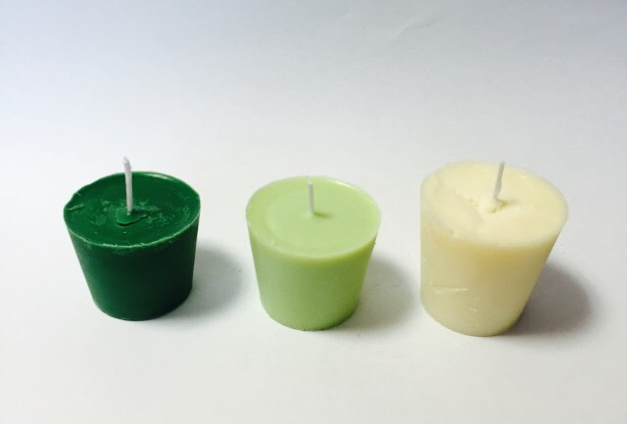

Slide 15
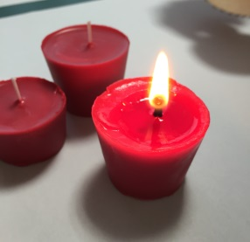
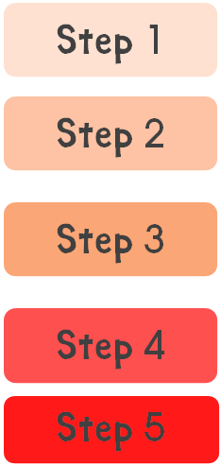
Step 1
Melt the soy wax in boiling water.
Step 2
Place the wick in the middle of the cup.
Step 3
Pour the wax into the cup.
Step 4
Pour the wax into the small cup.
Let it cool. (Wait it until about 65 degrees.)
Mix(Stir) it.
Step 5
Remove the paper cup from the candle.
Hold the wick with wooden sticks.
Add coloring and fragrance oil.
Let it Cool.

Slide 16


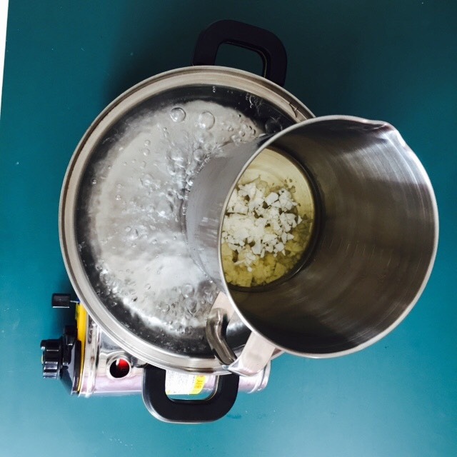
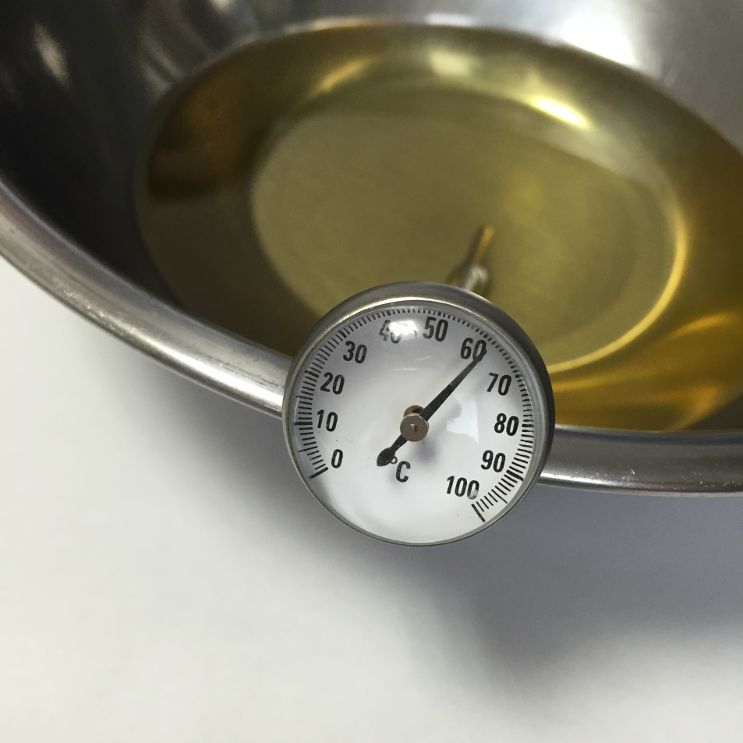
Step 1
  Melt the soy wax in boiling water.
  Make it cool. (Wait it until about 65 degrees.)
    60~65 degrees

Slide 17

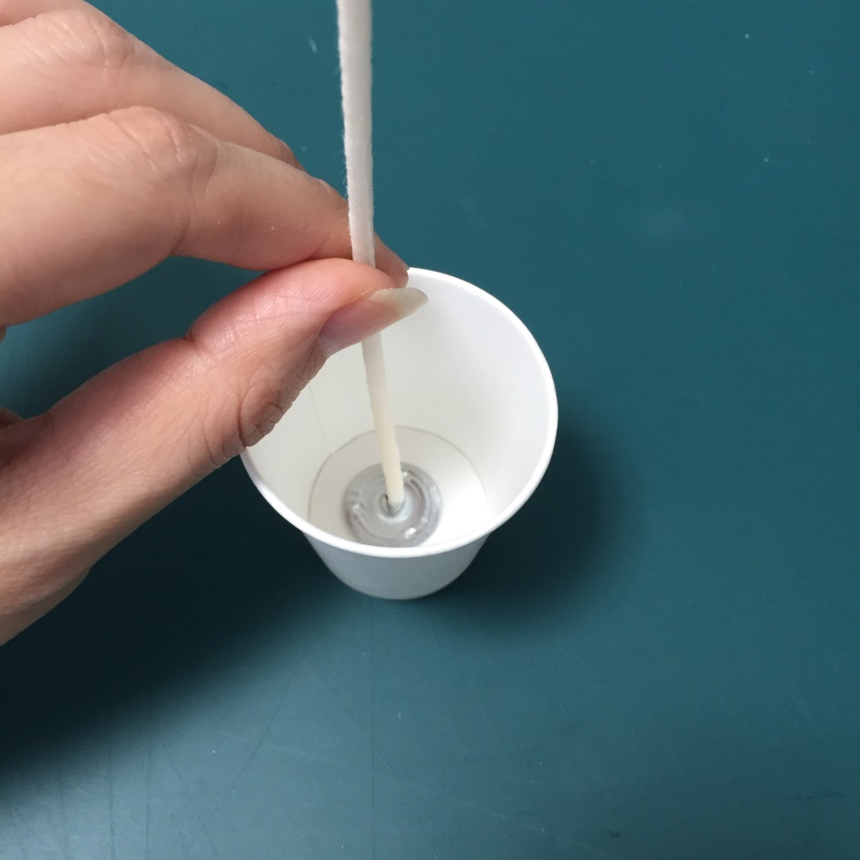
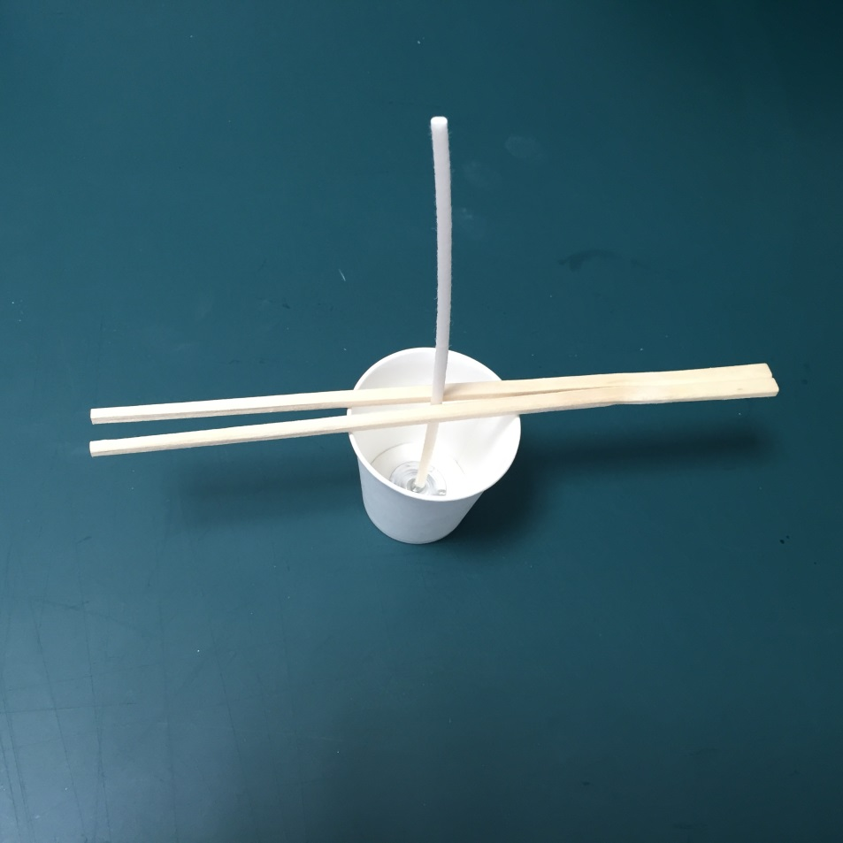
Step 2
Place the wick in the middle of the cup.
Hold the wick with wooden sticks.

Slide 18

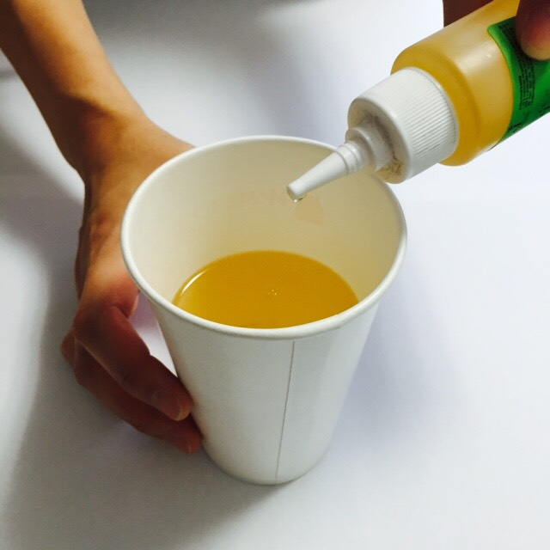
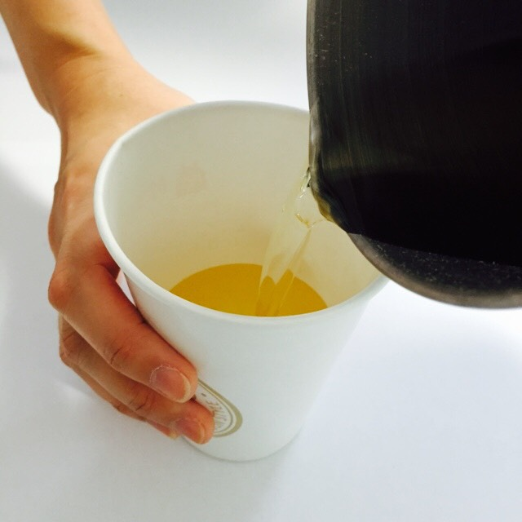
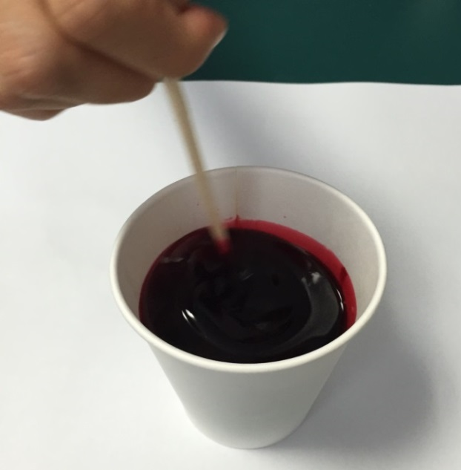
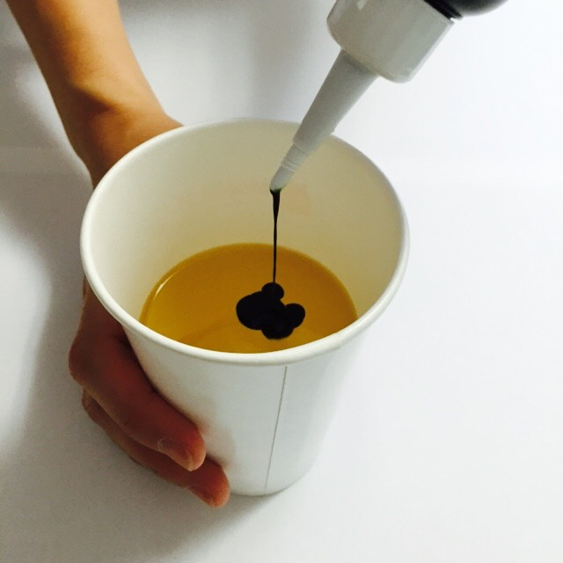
Step 3
Pour the wax into the cup.
Add coloring and fragrance oil.
Mix(Stir) it.

Slide 19

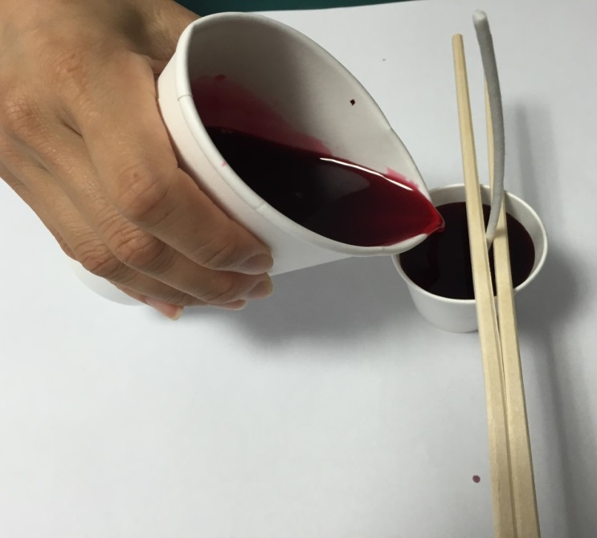
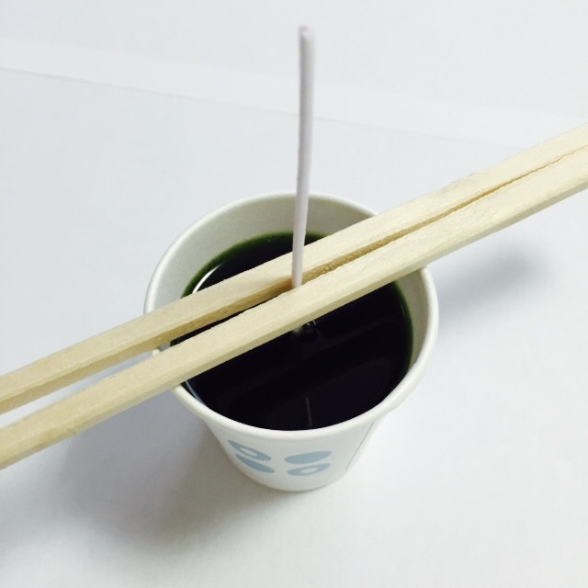
Step 4
Pour the wax into the small cup(s).
Let it(them) cool.
    50 degrees

Slide 20

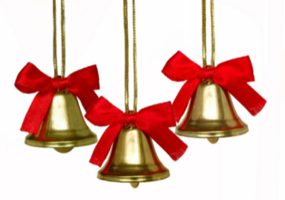


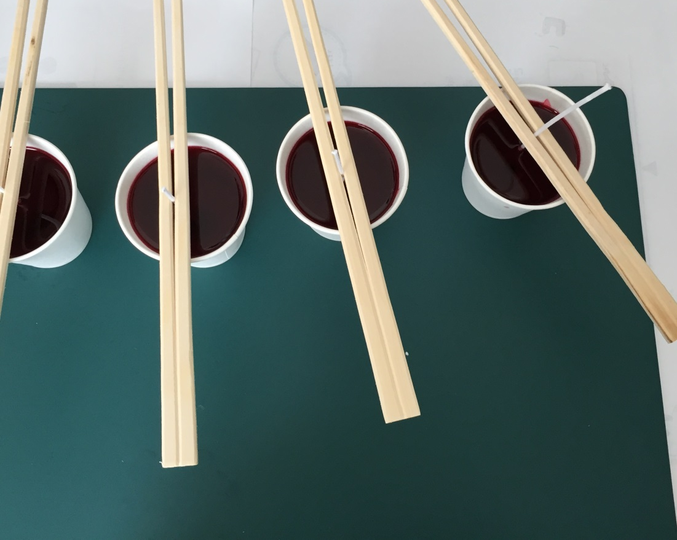
?
?
What will happen?
What will happen?

Slide 21
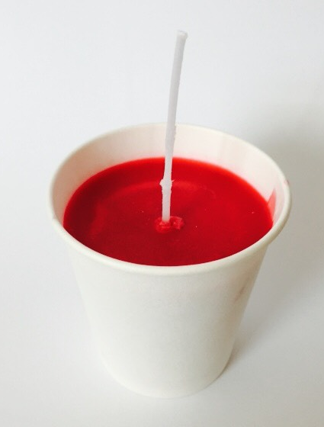
What happened to the candle?
It gets hard.
It is getting hard.
It is candle now.

Slide 22
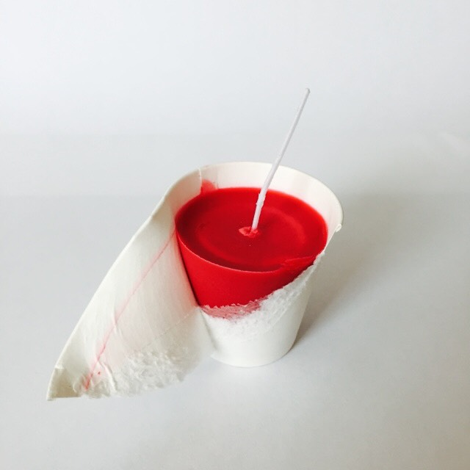
Step 5
Remove the paper cup from the candle.

Slide 23
Merry Christmas!

