Slide 1

White Christmas

Slide 2


White Christmas

Slide 3
White Christmas
I'm dreaming of a white Christmas
Just like the ones I used to know
Where the treetops glisten,
and children listen
To hear sleigh bells in the snow
I'm dreaming of a white Christmas
With every Christmas card I write
May your days be merry and bright
And may all your Christmases be white

Slide 4

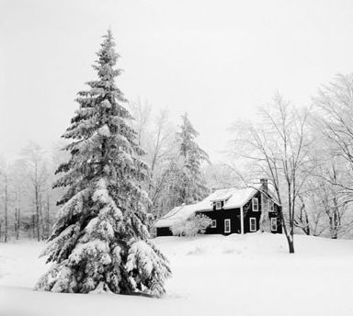
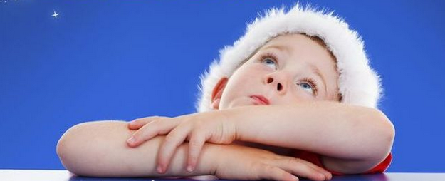
I'm dreaming of a white Christmas

Slide 5
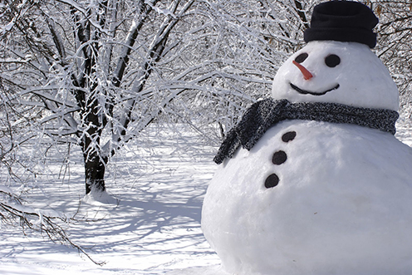
Just like the ones I used to know

Slide 6
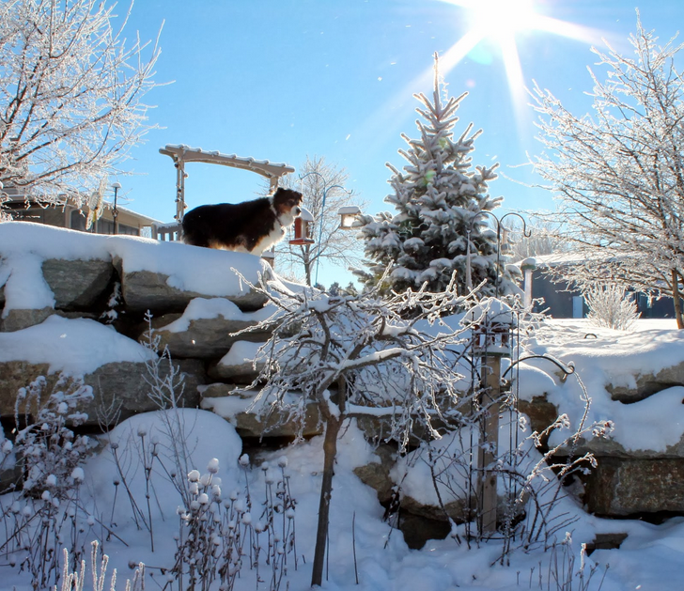
Where the treetops glisten,

Slide 7
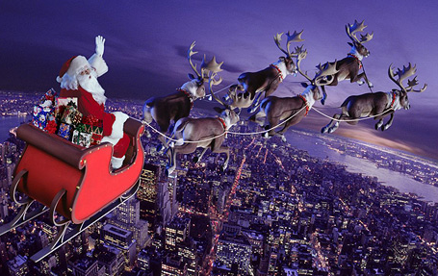
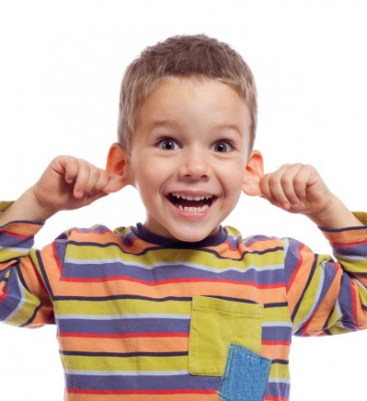
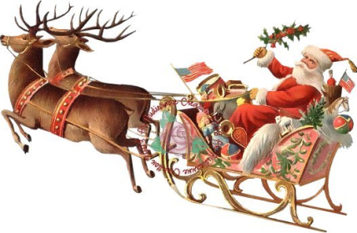
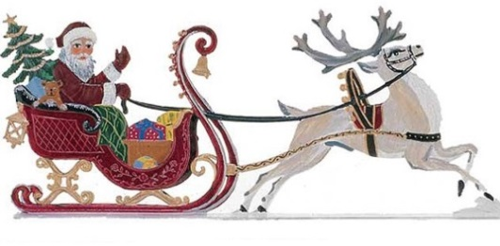
and children listen

Slide 8
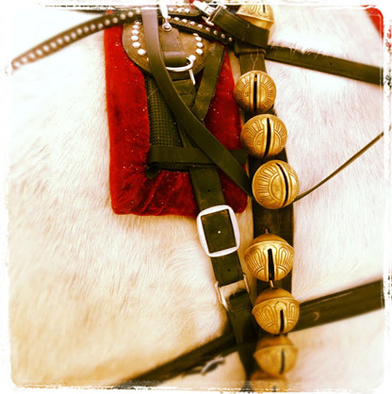
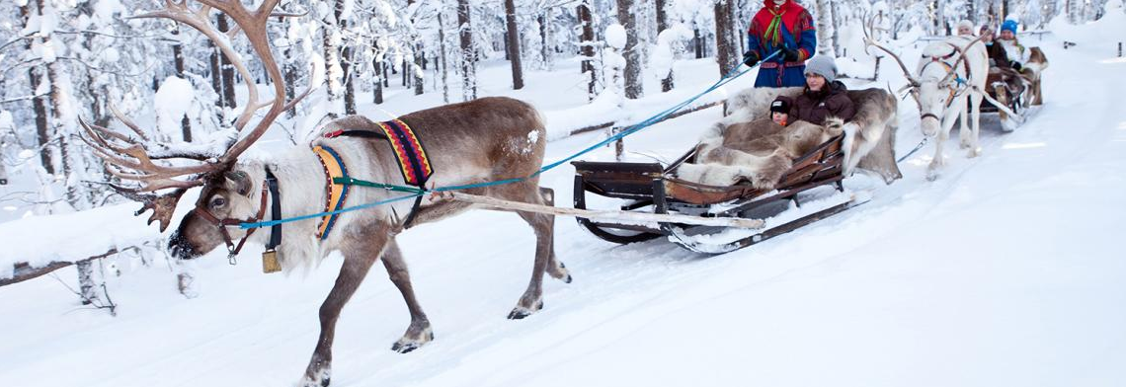
To hear sleigh bells in the snow

Slide 9
Part 2

Slide 10

I'm dreaming of a white Christmas

Slide 11

With every Christmas card I write

Slide 12
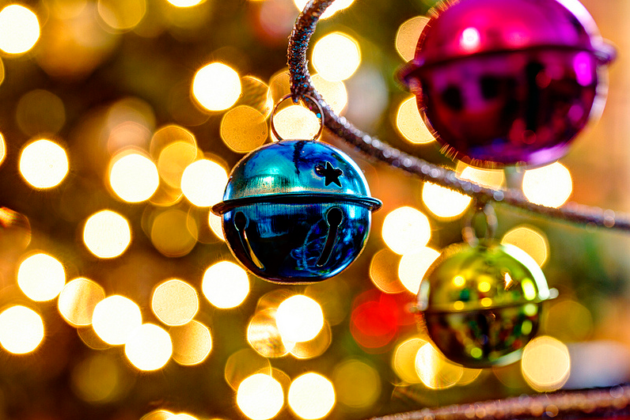
May your days be merry and bright

Slide 13
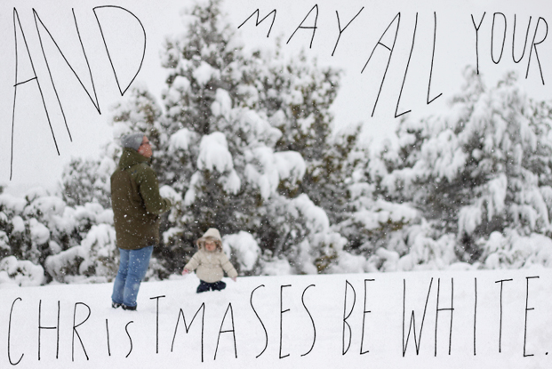
And may all your Christmases be white

Slide 14
I'm dreaming of a white Christmas

Slide 15
Just like the ones I used to know

Slide 16
Where the treetops glisten,

Slide 17
and children listen

Slide 18
To hear sleigh bells in the snow

Slide 19
I'm dreaming of a white Christmas

Slide 20
With every Christmas card I write

Slide 21
May your days be merry and bright

Slide 22

And may all your Christmases be white

Slide 23
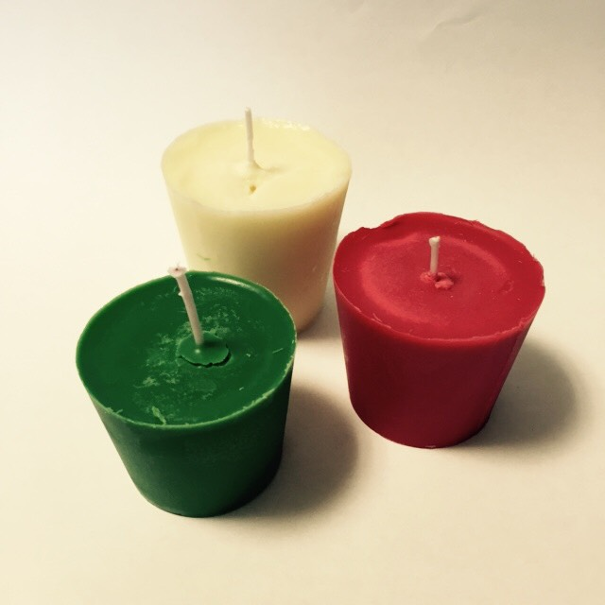
Merry Christmas!

