Slide 1
Group Game

Slide 2
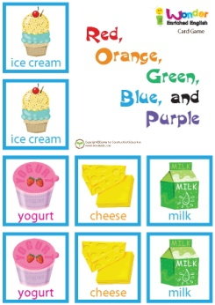
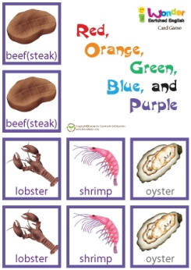
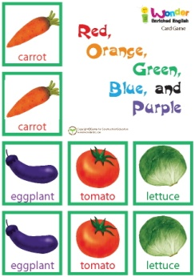
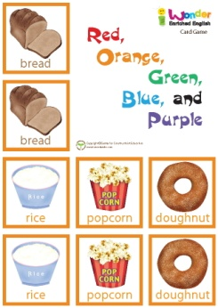
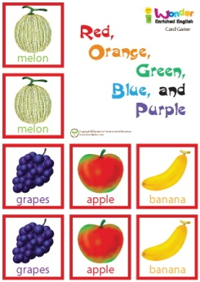
Group Game

Slide 3
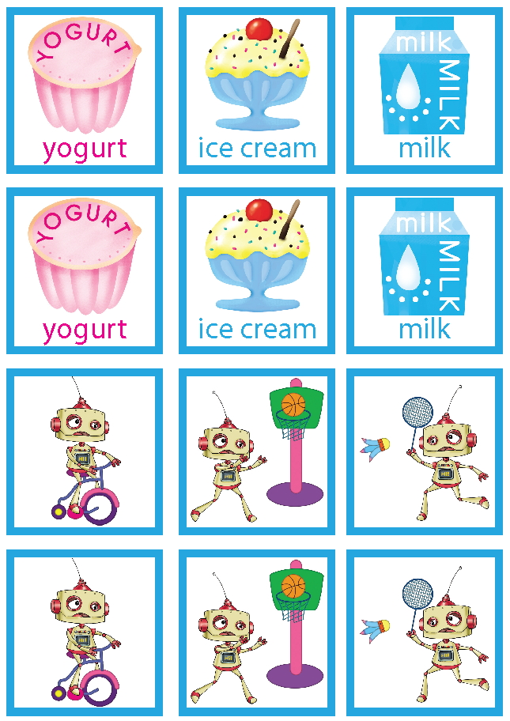
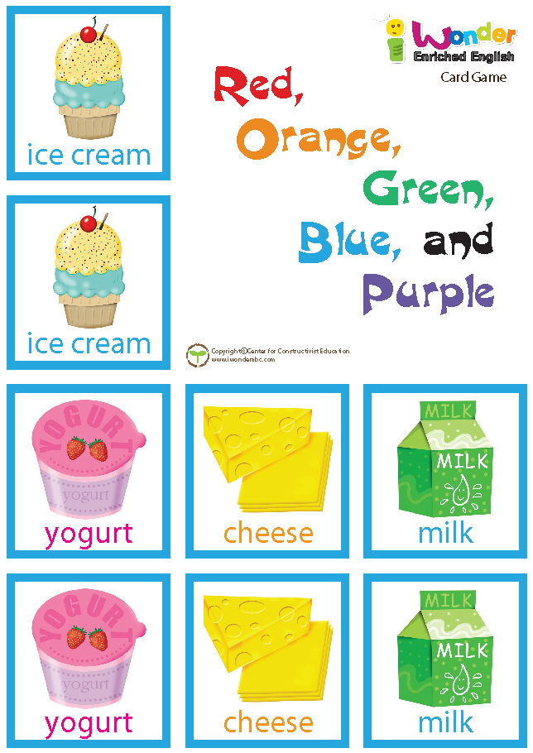
Let’s play the game.

Slide 4
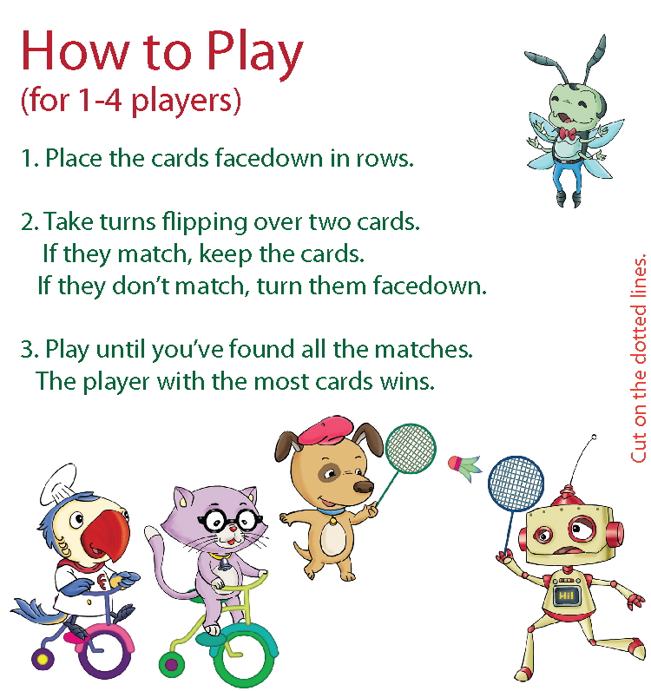
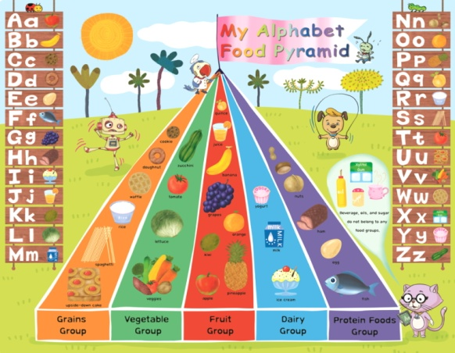
(For 1-4 players)

Slide 5
Let’s practice!
Who goes first?
Whose turn?
My turn!
It’s your turn.
The same or different?
Are they the same?
Are they different?
They are the same.
They are different.
Good job!
Good memory.
Try again.

